Slide 1

Project 1 Presentation Web – Design & Security
By:
Marco Peterson

Slide 2
IEEE Website Criteria
Member interaction through tools such as: forums, social media, RSS feeds, etc.
Content including all of the following: student branch contact information, section contact information, information about current branch events, other content as is applicable to the student branch.
Site Navigability including tools such as a search bar and site map.
Presentation including effective use of graphics and layouts. Please do not make pages crowded, dense, or hard to read.
Portability including support for a wide variety of browsers (including mobile browsers) and a short load time.

Slide 3
Website Point Deduction
Not having an IEEE logo on all pages that follows the IEEE logo guidelines
Copyright violations
Broken links
Spam/malware links
Website down for maintenance for an extended period of time

Slide 4
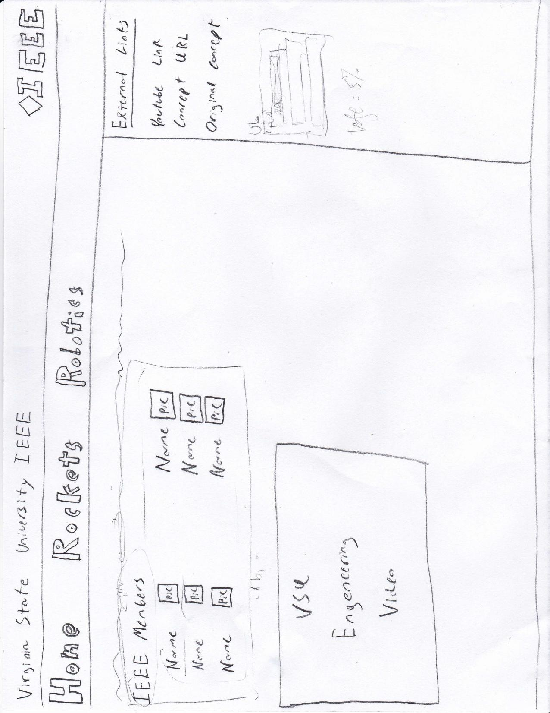
Original Concept

Slide 5
